Slide 1
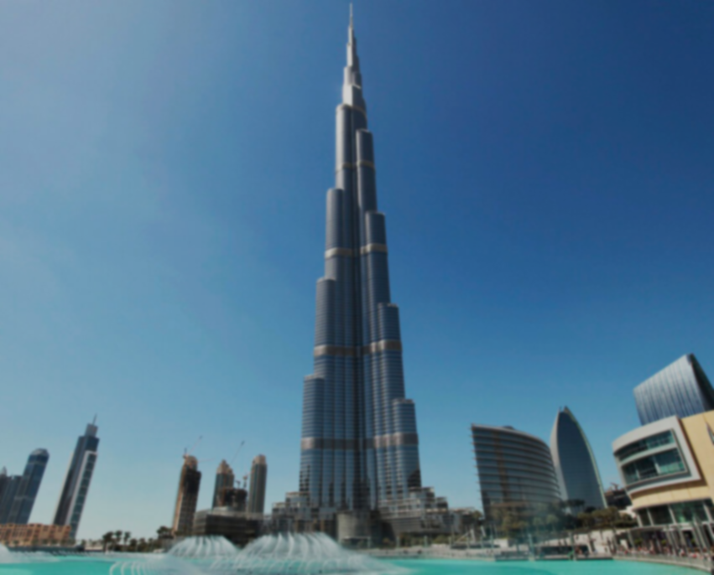
Burj Khalifa Skyscraper

Slide 2
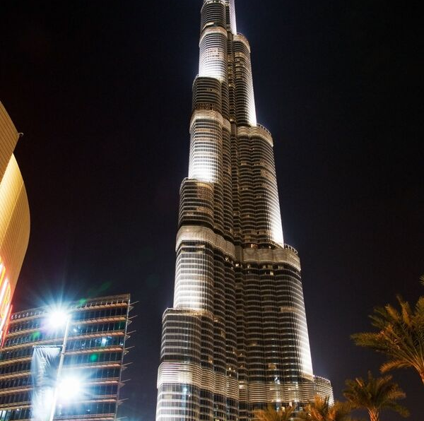
Burj Khalifa is the tallest building in the whole world, with a height of 828 meters, and a mass of 500 thousand tons

Slide 3
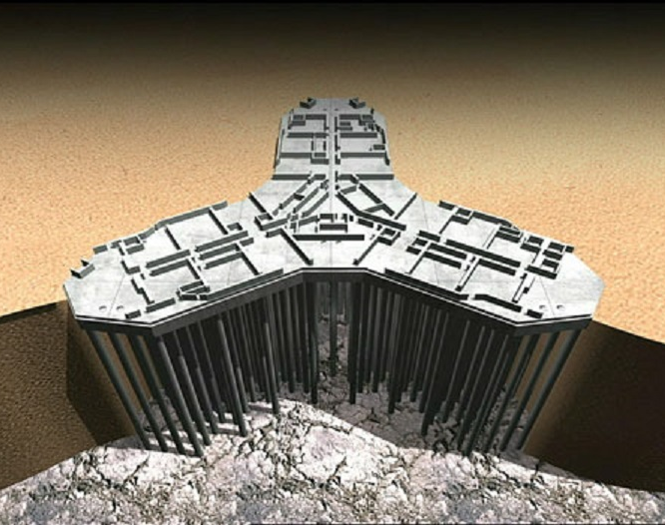
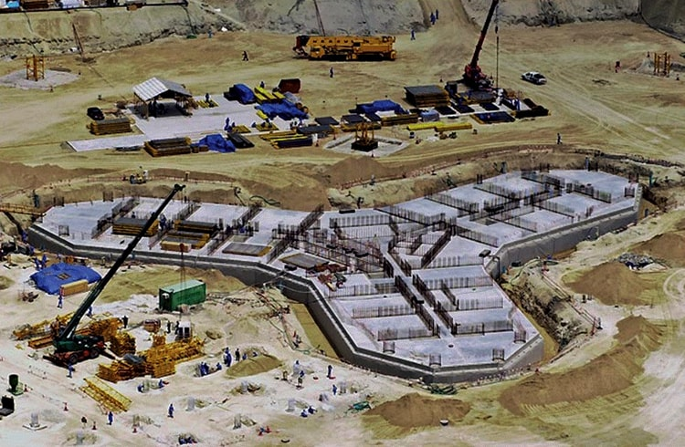
Burj Khalifa has an unusual foundation, because of the sandy soil around. For the foundation of the building, engineers preferred screw piles, there are more than 200 pieces

Slide 4
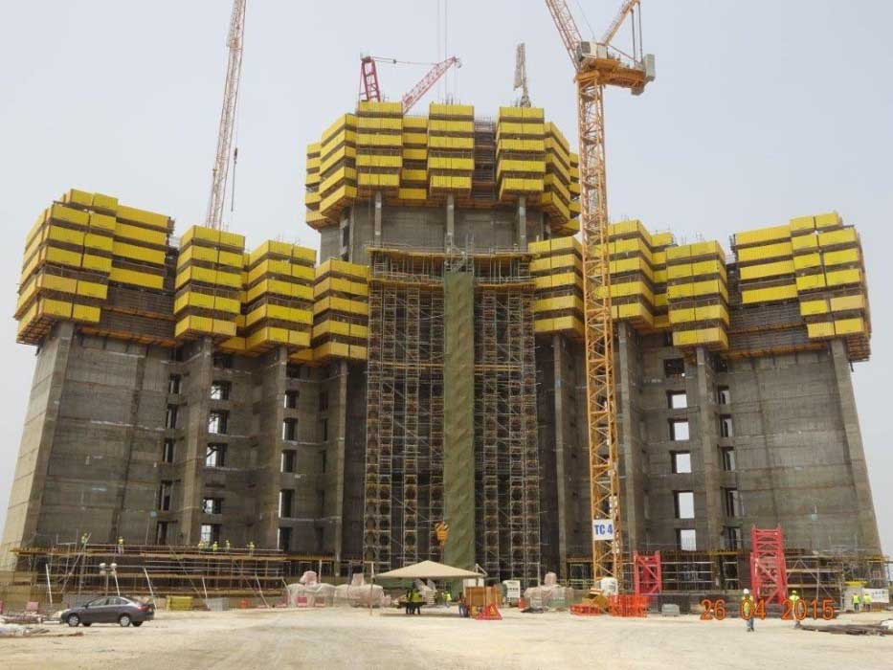
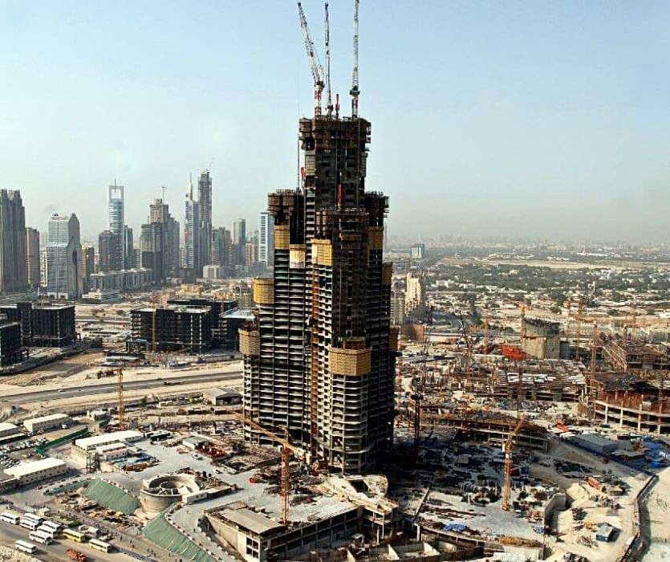
Construction of a skyscraper, February 2006
Already September 2006
In 2004, after a competition, the construction of the Burj Khalifa was started by Emaar Properties. The construction of the tower lasted six years and was carried out at a rate of one or two floors per week. The peculiarity of the construction was that the concrete mixture was laid only at night, and ice was added to the solution – otherwise the heat would not allow the concrete to gain the necessary strength when solidified

Slide 5
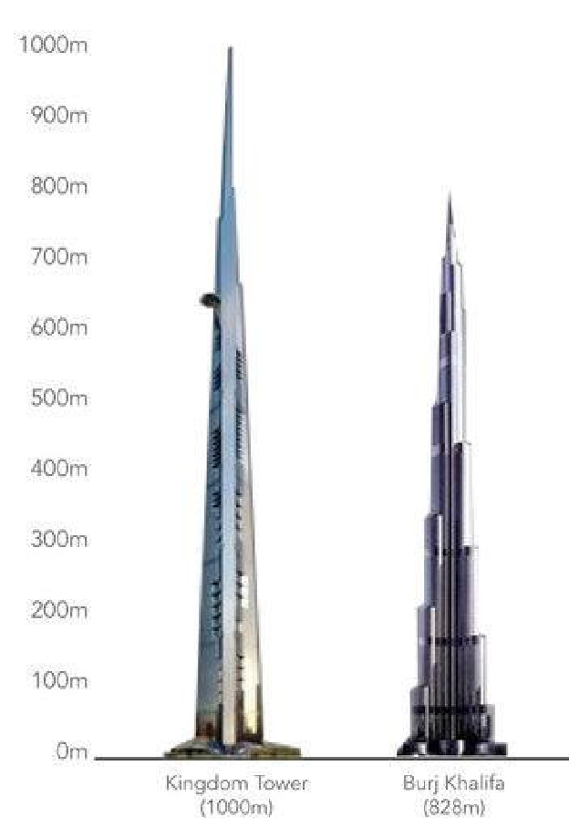
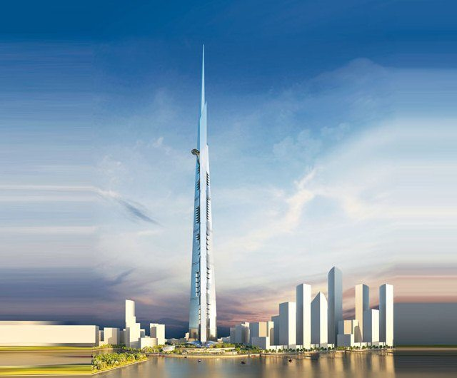
There is another concept of a skyscraper, which should be even higher than the Burj Khalifa, but in early 2018, the construction of the tower was suspended due to investigations and imprisonment of its main financiers. At the moment, construction is frozen

